Slide 1

Agata Białek
ESO workshop

Slide 2

Spin-off company founded in 2014 by engineers and managers from Centrum Badań Kosmicznych PAN and KW Mechatronics Sp. z o. o.
Areas of expertise:
Thermal subsystems of space instruments and satellites (simulation & design & manufacturing)
Space robotics (simulation & design)
Space subsystems (simulation & design)

Slide 3
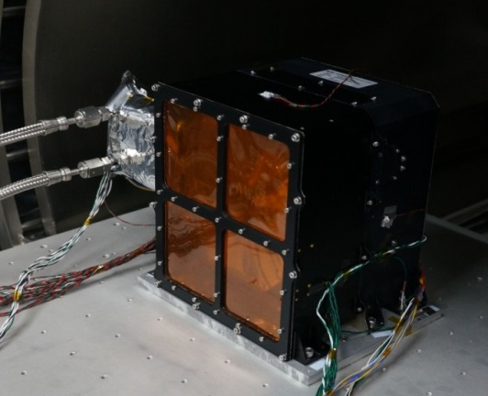
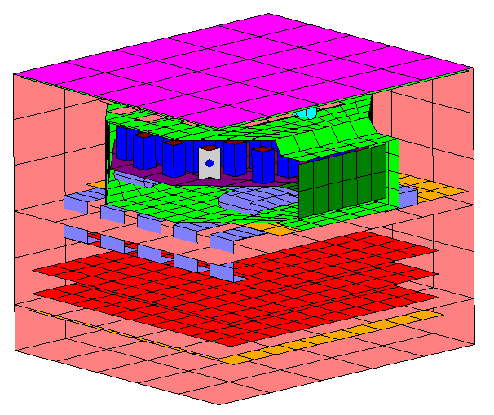
Activities
Ongoing activities:
  Thermal control system simulations, tests and correlation
  Thermal control system hardware development and verification: MLI and test bed system
Future plans
  Development of numerical tools for thermal tests and test results correlation
  Development of the technology for 3D shaping the MLI
  Developement and desing of precise isostatic actuators dedicated for mirrors
Correlated analyses parameters

Slide 4
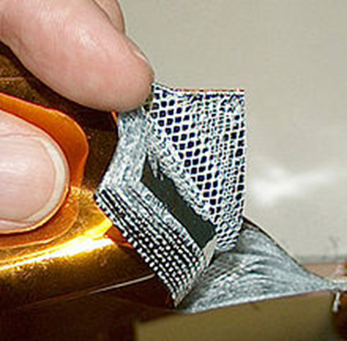
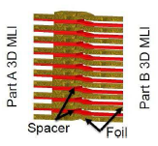
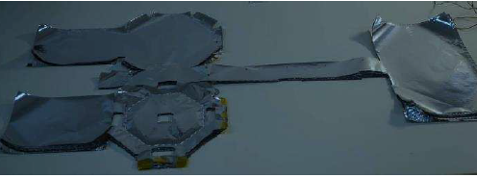
Ongoing activities
3D MLI
→

Slide 5
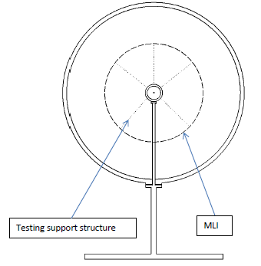
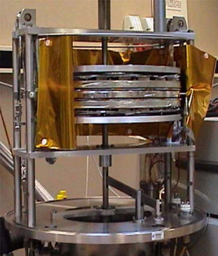
Ongoing activities
The test bed system for MLI insulation properties determination in 3D configuration
→
→ →
Credit: ESA
Credit: Spacive sp. z o. o.

Slide 6
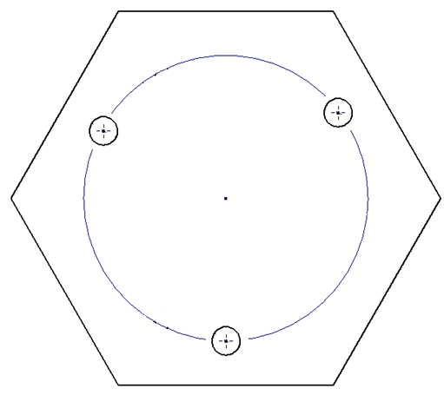
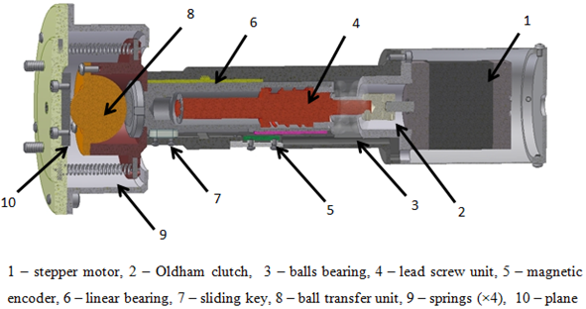
Design and development of precise isostatic actuators dedicated for mirrors
KEY CHARACTERISTIC
Two types of actuators - 1DoF and 2DoF
Isostatic mirrors fixation
High accuracy
IP 65
Can be controled by wireless driver
Mirror
Referent point
2 translational DoF
1 translational DoF
Notes:
Który jest ruchomy

Slide 7
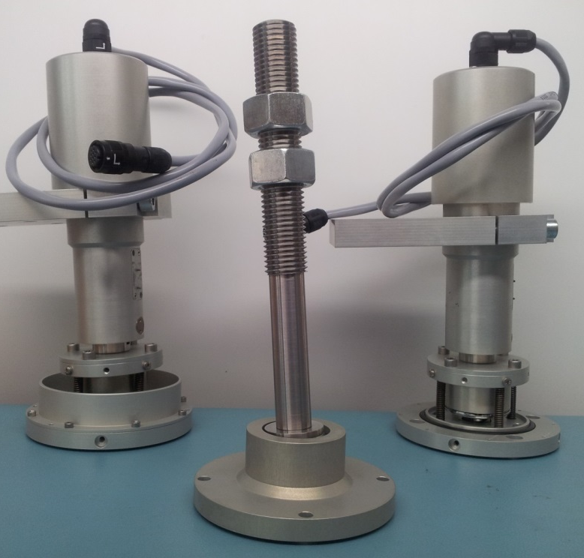
Design and development of precise isostatic actuators dedicated for mirrors
ACTUATORS PARAMETERS
Range of Drive | 20 mm
Elevation step size | 1,5 µm
Elevation accurancy | ±7µm
Elevation speed | 0,5 mm/s
Positioning encoding | Incrimental/Absolut (in 2mm pool lenght)
Moving force | >350 N
Holding force | Self-locking
Total actuator weight | ~ 1,5 kg
Operating voltage | 12 V
Standby current | 100 mA
Driving current | 600 mA
Actuators designed and developed by CBK PAN in the frame of CTA project.
Notes:
Który jest ruchomy

Slide 8
Thank you for your attention!
Contact details:
Agata Białek
CEO of Spacive Sp. z o. o.
abialek@spacive.pl

