Slide 1
Procurement @ ESO
Arnout Tromp
Head of Contracts and Procurement

Slide 2
Topics Addressed
Statistics
ESO Procurement Policy & Process
Procurement Vehicles
Selective Tendering
Collaborations with Institutes
Industrial return
E-ELT procurements
What’s in it for you?

Slide 3
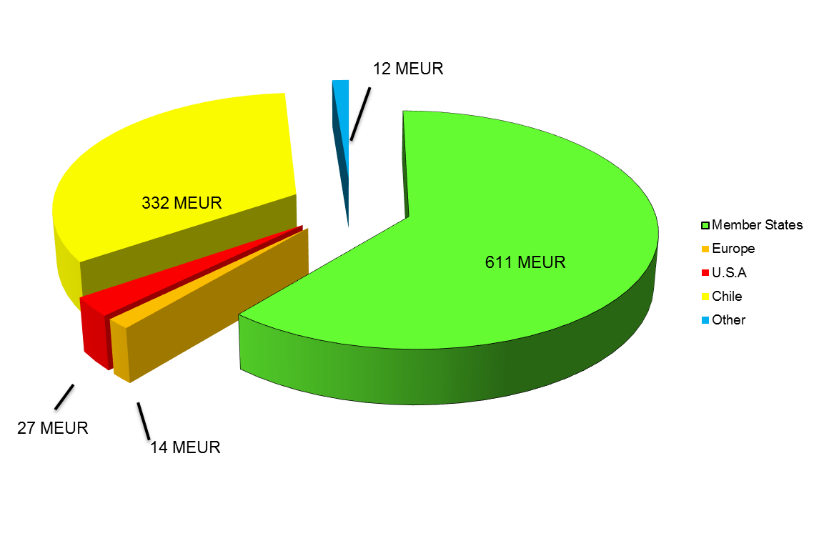
Contracts awarded worldwide over the period 2005 - 2014
Total Contracts 10 years: 996 Million EUR

Slide 4
Contracts awarded within ESO Member States over the period 2005 - 2014
Cumulative values, per “project”
Total Contracts 10 years, 611 Million EUR

Slide 5
Number of contracts awarded over the period 2005 - 2014
Number of contracts, for different price ranges

Slide 6
Procurement Policy (1/2)
Overall objective: technical excellence at an affordable cost.
In accordance with key principles for Public Procurement:
  Non-discrimination
  Transparency
  Accountability
  Fairness, economy and efficiency

Slide 7
Procurement Policy (2/2)
  Requirements from ESO Financial Rules and Regulations:
    Competitive Tendering;
    Within ESO Member States;
    Contracts awarded to the lowest priced technically and managerial compliant tender;
    Fair distribution of the contracts among the ESO Member States.
  Implemented through the ESO internal Procurement and Sales procedures.

Slide 8
Procurement Process (1/3)
ESO selects the recipients of its procurement actions from:
  Its database (categories), plus its staff’s own knowledge;
  Suggestions received from ESO Member States;
  Interest expressed by companies:
    In relation to forthcoming procurements announced on the ESO web page;
    Generically.
ESO gives great importance to the quality of its tenders, and expects the same from the bidders: “one shot only”, no room for improving a tender after its submission.

Slide 9
Procurement Process (2/3)
Evaluation of the managerial/technical evaluation of tenders performed without knowledge of the price(s);
Lowest priced compliant tender is awarded the order/ contract;
For each procurement above 150K EUR, an internal committee is constituted to follow through the evaluation and adjudication process.
Contracts/ Purchase Orders are regulated by ESO’s own set of contractual conditions (including recourse to private arbitration in case of disputes).

Slide 10
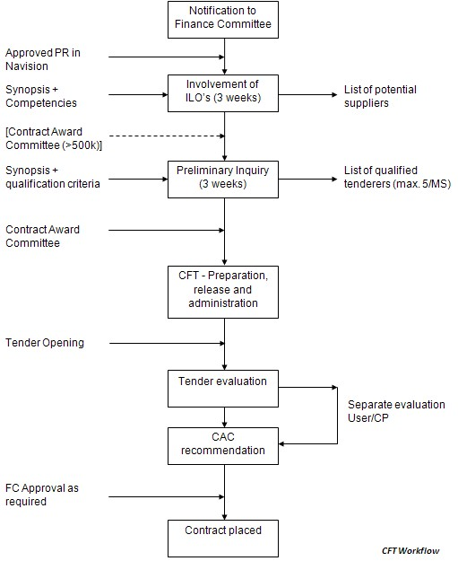
Procurement Process (3/3)
Typically used for Procurements
> 150k EUR

Slide 11
Procurement Vehicles (1/3)
Price Inquiries:
  For goods and services which are “standard” and do not call for an extensive definition of requirements;
  The schedule is ad-hoc, typically 3 to 4 weeks;
  The resulting order is regulated by the ESO General Conditions of Purchase Orders;
  Values are, as a general rule, < 150KEUR

Slide 12
Procurement Vehicles (2/3)
Call for Tender (CFT):
  Announced on the ESO CP web page;
  Mostly a 2 step process:
    Preliminary Inquiry: selection based on technical and financial suitability (response time: ~4 weeks);
    Competitive CFT: to all qualified companies; response time 6 weeks minimum.
Other:
  Request for Information (form free on a non-binding basis)
  Single Source procurements (only in justified cases)

Slide 13
Procurement Vehicles (3/3)
Structure of our procurement documentation:
  Preliminary Inquiry:
    Cover letter defining the content of the response
    Synopsis of the scope of work;
    The technical, financial, contractual qualification criteria;
    Administrative matters;
    ADs, as required (e.g. General Conditions of ESO Contracts)
  CFT:
    Cover letter
    Special Conditions
    Tender Form
    Draft contract
    General conditions
    SOW
    Technical Specifications

Slide 14
Selective Tendering
Our procurement actions are targeted =>
  You either know about it;
  or ESO knows about you and your competencies;
  or…..the opportunity is lost.
For procurements expected to exceed 150 KEUR, announcement is made on the ESO web page:
http://www.eso.org/public/industry/cp.html
=> companies have the opportunity to make their interest known to ESO (cp@eso.org).

Slide 15
Your Submission to ESO
Make your (first) tender your best tender, as it will be your only shot:
  Your reply needs to respond fully to the CFT requirements, specified in our “special conditions” => ask questions when you are unsure!!!!
  Same level of completeness required from new suppliers as for suppliers who have already contracted with ESO;
  Questions asked by ESO for clarification, and very selectively for missing information;

Slide 16
Collaborations with Institutes
Collaborations aimed at building instruments to be used at the telescopes;
Same principles applied as for procurements
(Transparency, equal treatment etc.);
Identification of institutes via scientific council delegate;
Remuneration via GTO and reimbursement of hardware cost.
Institutes mostly procure via EU tendering

Slide 17
Industrial return
No requirement for juste retour…but a strong expectation from all ESO Member States of an equitable distribution;
Measured through each country’s return coefficient: ratio between the percentage of expenditures in an individual MS and the MS percentage contribution to the budget;
Expenditures calculated on data collected from the Contractors re: the “origin of the supply”.

Slide 18
E-ELT procurement strategy
Basic principle: outsource all what can be efficiently performed by outside partners (industry or institutes) while keeping inside ESO the tasks where ESO has a long and specific experience not readily available outside .
  Examples of the first category are: detailed design, construction and integration of large structures (e.g. Dome, telescope Main Structure), high-precision optical mirror production, design, construction and integration of astronomical science instruments (by consortia of astronomical institutes).
  Examples of the second category are: specification, design and implementation of telescope control systems, AIV of high-precision opto-mechanical units, coating of large mirrors.

Slide 19
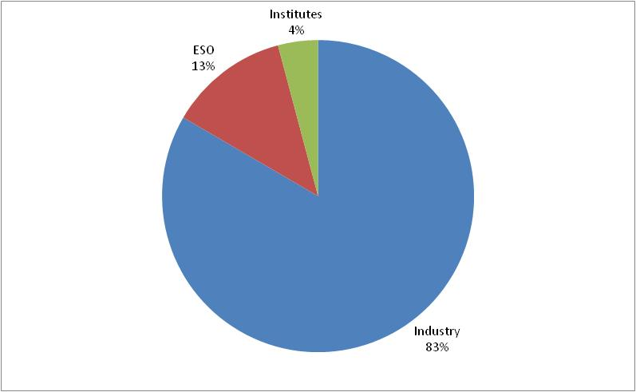
E-ELT where does the money go?

Slide 20
Near term procurements (1)
Polishing of the M1 Mirror Segments
(Phase 1: 588 segments, Phase 2: 343 additional)
  Polishing and integration with segment supports. Delivery to site at Armazones
    CfT planned for Q4 2015 with contract award in Q3 2016. Contract expected to run for 7 years.
  Looking for suppliers in MS and Chile with track record in large size, high performance, optics manufacturing and testing
Position Actuators for M1
  Design, manufacture and deliver Electro-mechanical precision actuators (φ1: 1764, φ2: +646) and electronic controllers (φ1: 588, φ2: +216) to be mounted on each M1 Cell
  Procurement start 2017 (TBC) expected to run for 5-6 years
  Suitable for medium size (turnover 10-15 MEURO) to large suppliers in MS and Chile with track record in high precision position actuators design and manufacturing

Slide 21
Near term procurements (2)
Edge Sensors for M1
  Contract(s) for the production of edge sensors (φ1: 3318, φ2: +1312) controllers, tools and interfaces.
  Contract to start end 2016 (Nov 2016 FC) to run for 5 years
  Looking for medium large size (turnover 10-15 MEURO) suppliers in MS and Chile with track record in non contact nanometer accuracy displacement sensors
Segment Supports for M1 (serial production)
  Contract (s) for the production of segment precision mechanical supports (φ1: 588, φ2: +343) and fixed frames (φ1: 588, φ2: +210), tooling and transport containers.
  Procurement in 2018 (May 2018 FC) to run for 4 years
  Looking for medium to large size (turnover above 30-60 MEURO) suppliers in MS and Chile with track record in precision mechanics manufacturing and integration

Slide 22
Near term procurements (3)
M2 Cell (jointly with M3 cell)
  M2 Cell design and production of whiffletree steel frame structure, mechanical supports and tools. Integration with dummy mirror (from mirror supplier)
  Contract to run during 2016 to 2021 (Nov 2016 FC)
  Looking for medium/large size (turnover > 20 MEURO) suppliers in MS and Chile with track record in large optics manufacturing, large opto-mechanical systems design and manufacturing
M2 Mirror Blank (possibly jointly with M3 blank)
  Contract to run during 2017/18 (Nov 2016 FC)
  Looking for medium-large size (turnover > 20 MEURO) suppliers in MS and Chile with track record in large glass ceramic blanks manufacturing.

Slide 23
Near term procurements (4)
Infrastructure telescope control
  SW design and development of the core integration infrastructure for the Telescope Control System (TCS)
  Possible procurement end 2016 (Nov 2016 FC)
  Looking for suppliers in MS and Chile
Infrastructure for Real time computer (RTC)
  SW development environment, computer and network infrastructure
  Procurement during 2017 (Nov 2017 FC)
  Looking for in MS and Chile with track record in supply of SDE (SW Dev. Env.)

Slide 24
Near term procurements (5)
WaveFront Sensor (WFS) Detectors
  Procurement of wavefront sensors. Design and production of the detector and associated controller, it includes the optomechanical subassemblies that sample the wavefront (e.g. lenslet array)
  Procurement during 2016/17 (May 2017 FC)
  Looking for suppliers in/and outside MS and Chile with track record in of scientific optical mechanical systems
Mirror Washing units
  4 meter mirrors and M1 washing units
  Procurement late 2016 (Nov 2016 FC)
  Looking for medium size (turnover 5-10 MEURO) suppliers in MS and Chile with track record in design and manufacturing of cleaning/stripping equipment (chemical cleaning/stripping)

Slide 25
Near term procurements (6)
M1 Mirror Coating units
  Coating units used to coat the M1 segments on site
  Procurement 2017 (Nov 2017 FC)
  Looking for medium size (turnover 10-15 MEURO) suppliers in MS and Chile with track record in design and manufacturing of coating/vacuum thin film deposit equipment

Slide 26
Request for Information (identify companies and gather information)
  M1, M2 and M3 mirror blanks (replies received, evaluating)
  M2 and M3 cells (in preparation for August)
Preliminary Inquiry (pre-selection based on financial and tech. info)
  Edge Sensors (waiting for replies)
  M1 segment polishing, M2 blank (in preparation for Q3)
Call for tenders running
  ISVV, Independent SW Validation and Verification Consultancy
  Quality Assurance and Quality Control Consultancy Service
  Dome and Main Structure

Slide 27
What is in it for you?
Business opportunity
Publicity: you get the change to contribute to the build of very complex machines with high potential
It can provide you the opportunity for free R&D
Potential spin offs of the developments made

Slide 28
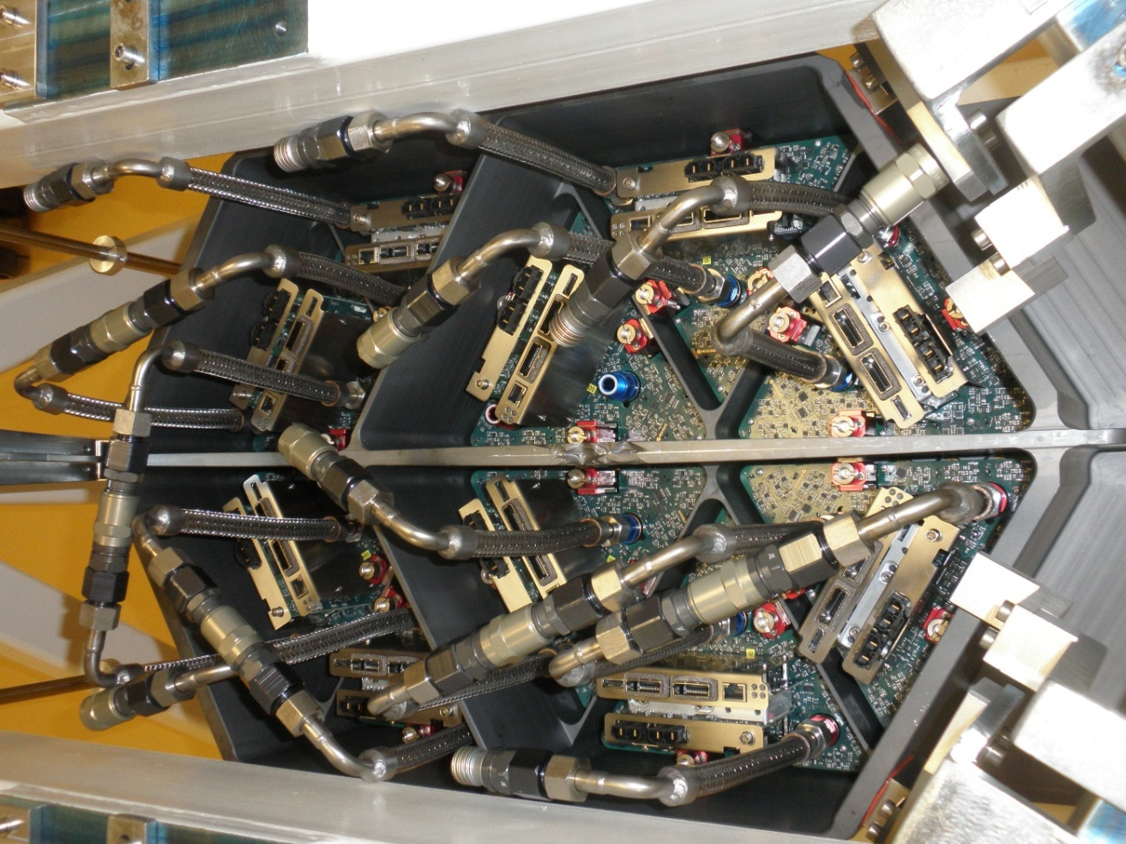
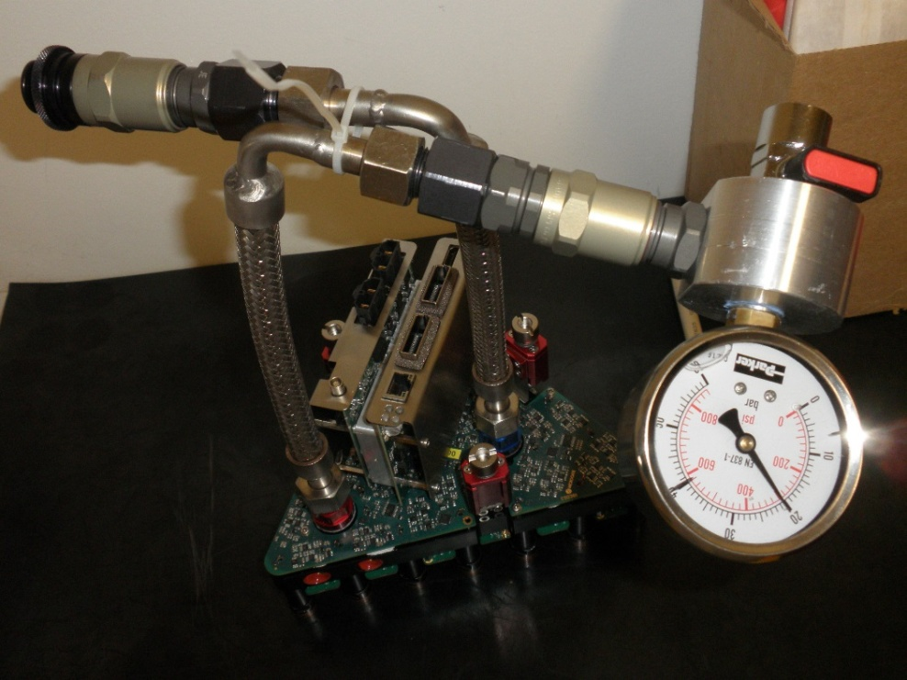
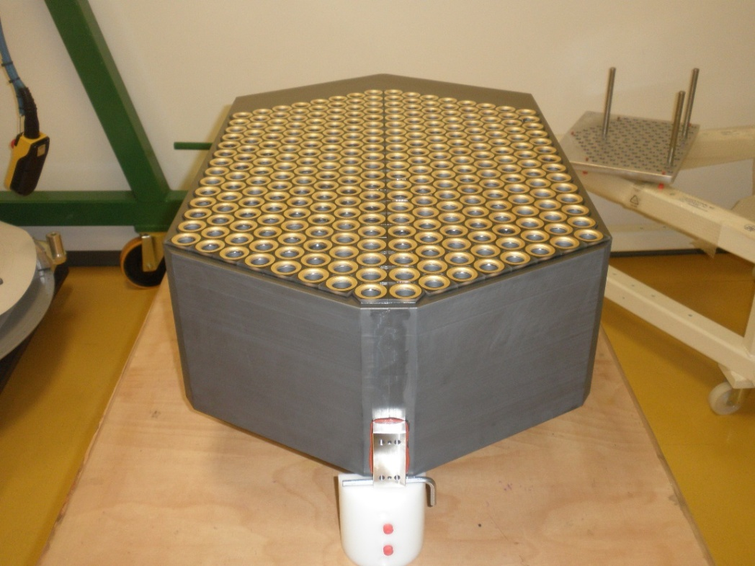

Spin off

Slide 29

Questions?

